Slide 1


EMERGENCY EVACUATION PATH PLANNER
T. Sharon Rhoda - 2520040001
J. Krishna Chaithanya - 2520040049

Slide 2
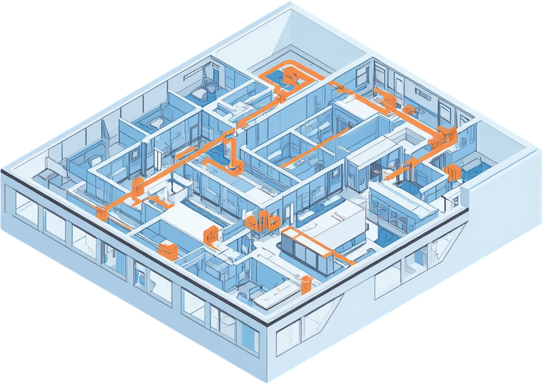

CONTENTS
Introduction
System Analysis
Working Process
Results

Slide 3


INTRODUCTION
Emergency evacuation systems are critical for safeguarding lives during crises such as fires, earthquakes, and security threats. Traditional evacuation relies on static signage and predetermined routes that cannot adapt to real-time conditions. When exits become blocked or hazards spread, these fixed paths may lead occupants into danger rather than safety. This project addresses these limitations through intelligent, dynamic path planning that responds to changing emergency conditions in real-time. By leveraging graph-based building representations and advanced pathfinding algorithms including Dijkstra's Algorithm, A* Search, and Breadth-First Search, our system calculates optimal evacuation routes instantly and continuously updates guidance as situations evolve.
page 003

Slide 4




ABSTRACT
This project presents an intelligent evacuation system designed to ensure safe and efficient building evacuation during emergencies such as fires, earthquakes, and security threats. The system represents building layouts as graph data structures, enabling dynamic path planning through interconnected nodes and edges. Utilizing advanced pathfinding algorithms including Dijkstra's Algorithm and A* Search, the system calculates optimal evacuation routes in real-time. When hazards are detected or exits become blocked, routes are instantly recalculated to guide occupants to the nearest safe exit. Key objectives include faster evacuation times, enhanced occupant safety, and reduced congestion through multiple exit options and adaptive routing capabilities.
page 04

Slide 5

HARDWARE
REQUIREMENTS
Processor (Intel i3/i5+)
Storage (20GB Free)
RAM (4GB Minimum)
IoT Sensors & Devices
page 007

Slide 6

SOFTWARE
REQUIREMENTS
Operating System
Core Libraries
Python Language
Development Tools
The Emergency Evacuation Path Planner requires a comprehensive software stack to enable dynamic pathfinding capabilities. Python serves as the primary programming language due to its extensive library ecosystem and rapid prototyping capabilities. The NetworkX library provides robust graph data structures essential for building layout representation, while Matplotlib and NumPy handle visualization and numerical computations. Development is conducted in VS Code or PyCharm IDEs with MySQL/SQLite for data persistence and Git for version control.
page 008

Slide 7



EXISTING SYSTEM ARCHITECTURE
Current evacuation systems follow a rigid, linear flow: Emergency Occurs → Fixed Evacuation Map → Occupants Follow Predefined Route → Reach Exit. This architecture relies entirely on static signage and predetermined paths that cannot adapt to real-time conditions.
Key Drawbacks:
• No hazard detection capability - system unaware of blocked exits or danger zones
• No alternative path calculation when primary routes become unsafe
• Static routes remain unchanged regardless of emergency type or location
• Single point of failure if designated exit becomes inaccessible
• Results in congestion, delays, and increased safety risks
page 010

Slide 8


PROPOSED SYSTEM
ARCHITECTURE
Dynamic Pathfinding Engine
Core algorithms process the graph:
• A* Algorithm - Heuristic-based optimal routing
• Dijkstra's Algorithm - Guaranteed shortest path
• BFS - Rapid unweighted path discovery
Safe Route Calculation
Generates optimal evacuation paths avoiding hazards and congestion points.
User Guidance System
Delivers real-time directions via displays, mobile alerts, and audio announcements.
Emergency Exit
Occupants reach nearest safe exit efficiently.
page 012

Slide 9


KEY
ADVANTAGES
Faster Evacuation Times
Hazard-Aware Routing
Reduced Congestion
www.university.edu/cse
page 15

Slide 10


PRACTICAL
APPLICATIONS
Shopping Malls
01.
Airports & Stations
02.
Hospitals & Schools
03.
Smart City Systems
04.
page 016

Slide 11





PROJECT
CONCLUSION
The Emergency Evacuation Path Planner demonstrates significant advancement in building safety technology. By combining real-time hazard detection with dynamic pathfinding algorithms (Dijkstra's, A*, BFS), the system addresses critical limitations of static evacuation approaches. Key achievements include adaptive route recalculation when exits become blocked, reduced evacuation times through intelligent path optimization, and enhanced occupant safety via hazard-aware routing. The graph-based building representation enables scalability across diverse environments from hospitals to airports. This intelligent system is ready for practical deployment, offering a robust solution that transforms emergency response from rigid predetermined routes to flexible, life-saving dynamic guidance.
page 18

Slide 12

THANK
YOU.

